Slide 1
Teamwork skills: Communicating and problem solving

Slide 2
Teamwork skills: Communicating and problem solving

Slide 3
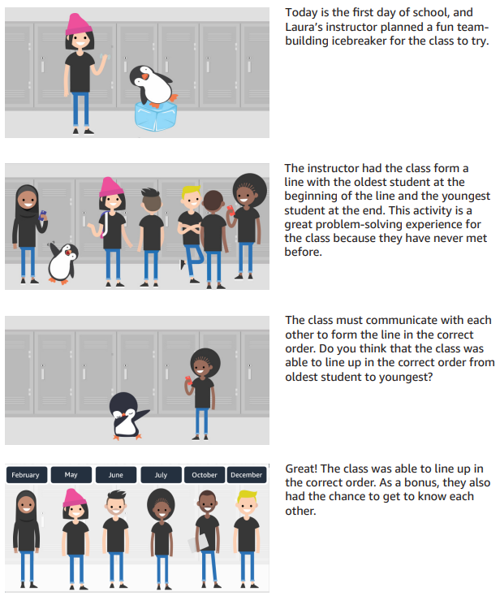
Teamwork skills: Communicating and problem solving
Notes:
Original Content: MODULE 3 Design thinking: Ideate In previous sessions, you began to learn about the design thinking cycle. In this session, you continue putting what you learned to use. You also learn about working backwards to get to a solution. By the end of today’s session, you will have the tools to begin the ideate phase of the design process. You’ll also learn skills and techniques that you can use to become a great team member. Ideate recap 3 . Ideate To ideate is to imagine a solution to the problem that you want to solve. This step is a fun part of design thinking because you get to brainstorm and come up with many ideas to solve your problem. Teamwork skills for success When brainstorming for your app, you must collaborate with your team to come up with your potential ideas. What do these great teamwork skills look like?

Slide 4
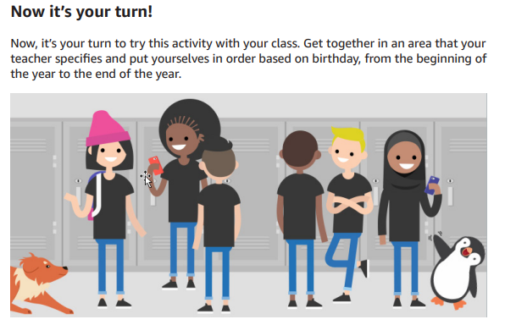
Teamwork skills: Communicating and problem solving
Notes:
Original Content: MODULE 3 Design thinking: Ideate In previous sessions, you began to learn about the design thinking cycle. In this session, you continue putting what you learned to use. You also learn about working backwards to get to a solution. By the end of today’s session, you will have the tools to begin the ideate phase of the design process. You’ll also learn skills and techniques that you can use to become a great team member. Ideate recap 3 . Ideate To ideate is to imagine a solution to the problem that you want to solve. This step is a fun part of design thinking because you get to brainstorm and come up with many ideas to solve your problem. Teamwork skills for success When brainstorming for your app, you must collaborate with your team to come up with your potential ideas. What do these great teamwork skills look like?

